Slide 1
MapReduce: Data Distribution for Reduce
- HEENA DAVE
- BHAVY BHUT

Slide 2
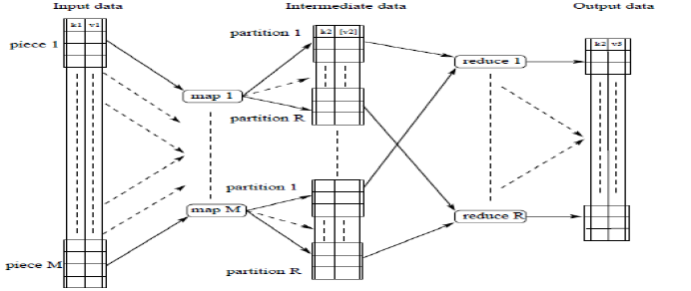
Data Distribution MapReduce
After Key-Value generation by Map workers, pairs are grouped together
and partitioned into R chunks and each partitioned data is assigned to
one reduce worker.

Slide 3
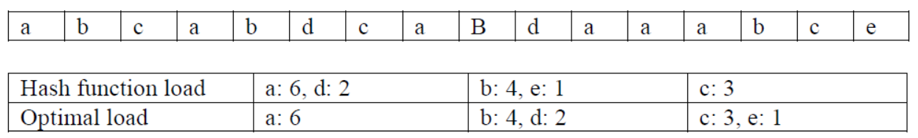
Problems with existing data distribution
It shows scenario of hash function load balancing and optimal load balancing for three reduce workers.
Hash function assigns keys a and d to first machine, b and e to second
machine and only c to third machine.
As result first machine has maximum load of 8 while third machine has
only load of 3.
As shown in optimal load, hash function load balancing is not effective.
Reference: Yanfang Le, Jiangchuan Liu, Funda Erg¨un, Dan Wang, "Online Load Balancing for MapReduce with Skewed Data Input"

Slide 4
Our strategy for data distribution
Even data distribution among reducers.
Sorted map keys, so that same key mapper output have higher chances of being executed on same reducer except it the data is overloaded on one
reducer.
One map output is distributed among different reducers.
One final reducer to combine output of all the reducers.

Slide 5
System Requirements
Hardware
Processor: 1.8 GHz or higher
RAM: 8 GB or higher
Network: 1 GB onboard
Software
Library: Apache Hadoop which we use as distributed data storage and Yarn for job scheduling
Java: Java Sdk 6 or higher which supports Hadoop
IDE: Eclipse IDE for source code
DBMS: not required

Slide 6
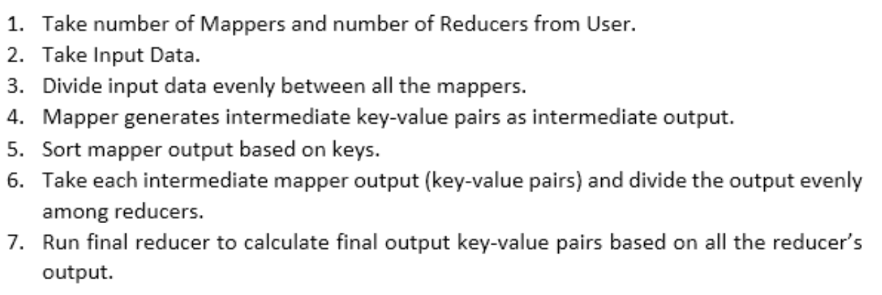
Algorithm

Slide 7
Advantages over Traditional MapReduce
Effective utilization of reducers as mapper output is evenly distributed and all the reducers finish their task almost simultaneously.
No reducer will have numerous keys to process.
No reducer will wait sitting idle for a long time for a busy reducer to
finish its task.

Slide 8
Performance Comparison

Slide 9
Performance Comparison

Slide 10
Performance Comparison

Slide 11
Future Work
Future work is to implement algorithm on node architecture and compare results with Hadoop MapReduce and other MapReduce Frameworks.
Evaluate performance for distributed systems.

Slide 12


Slide 13


